Slide 1
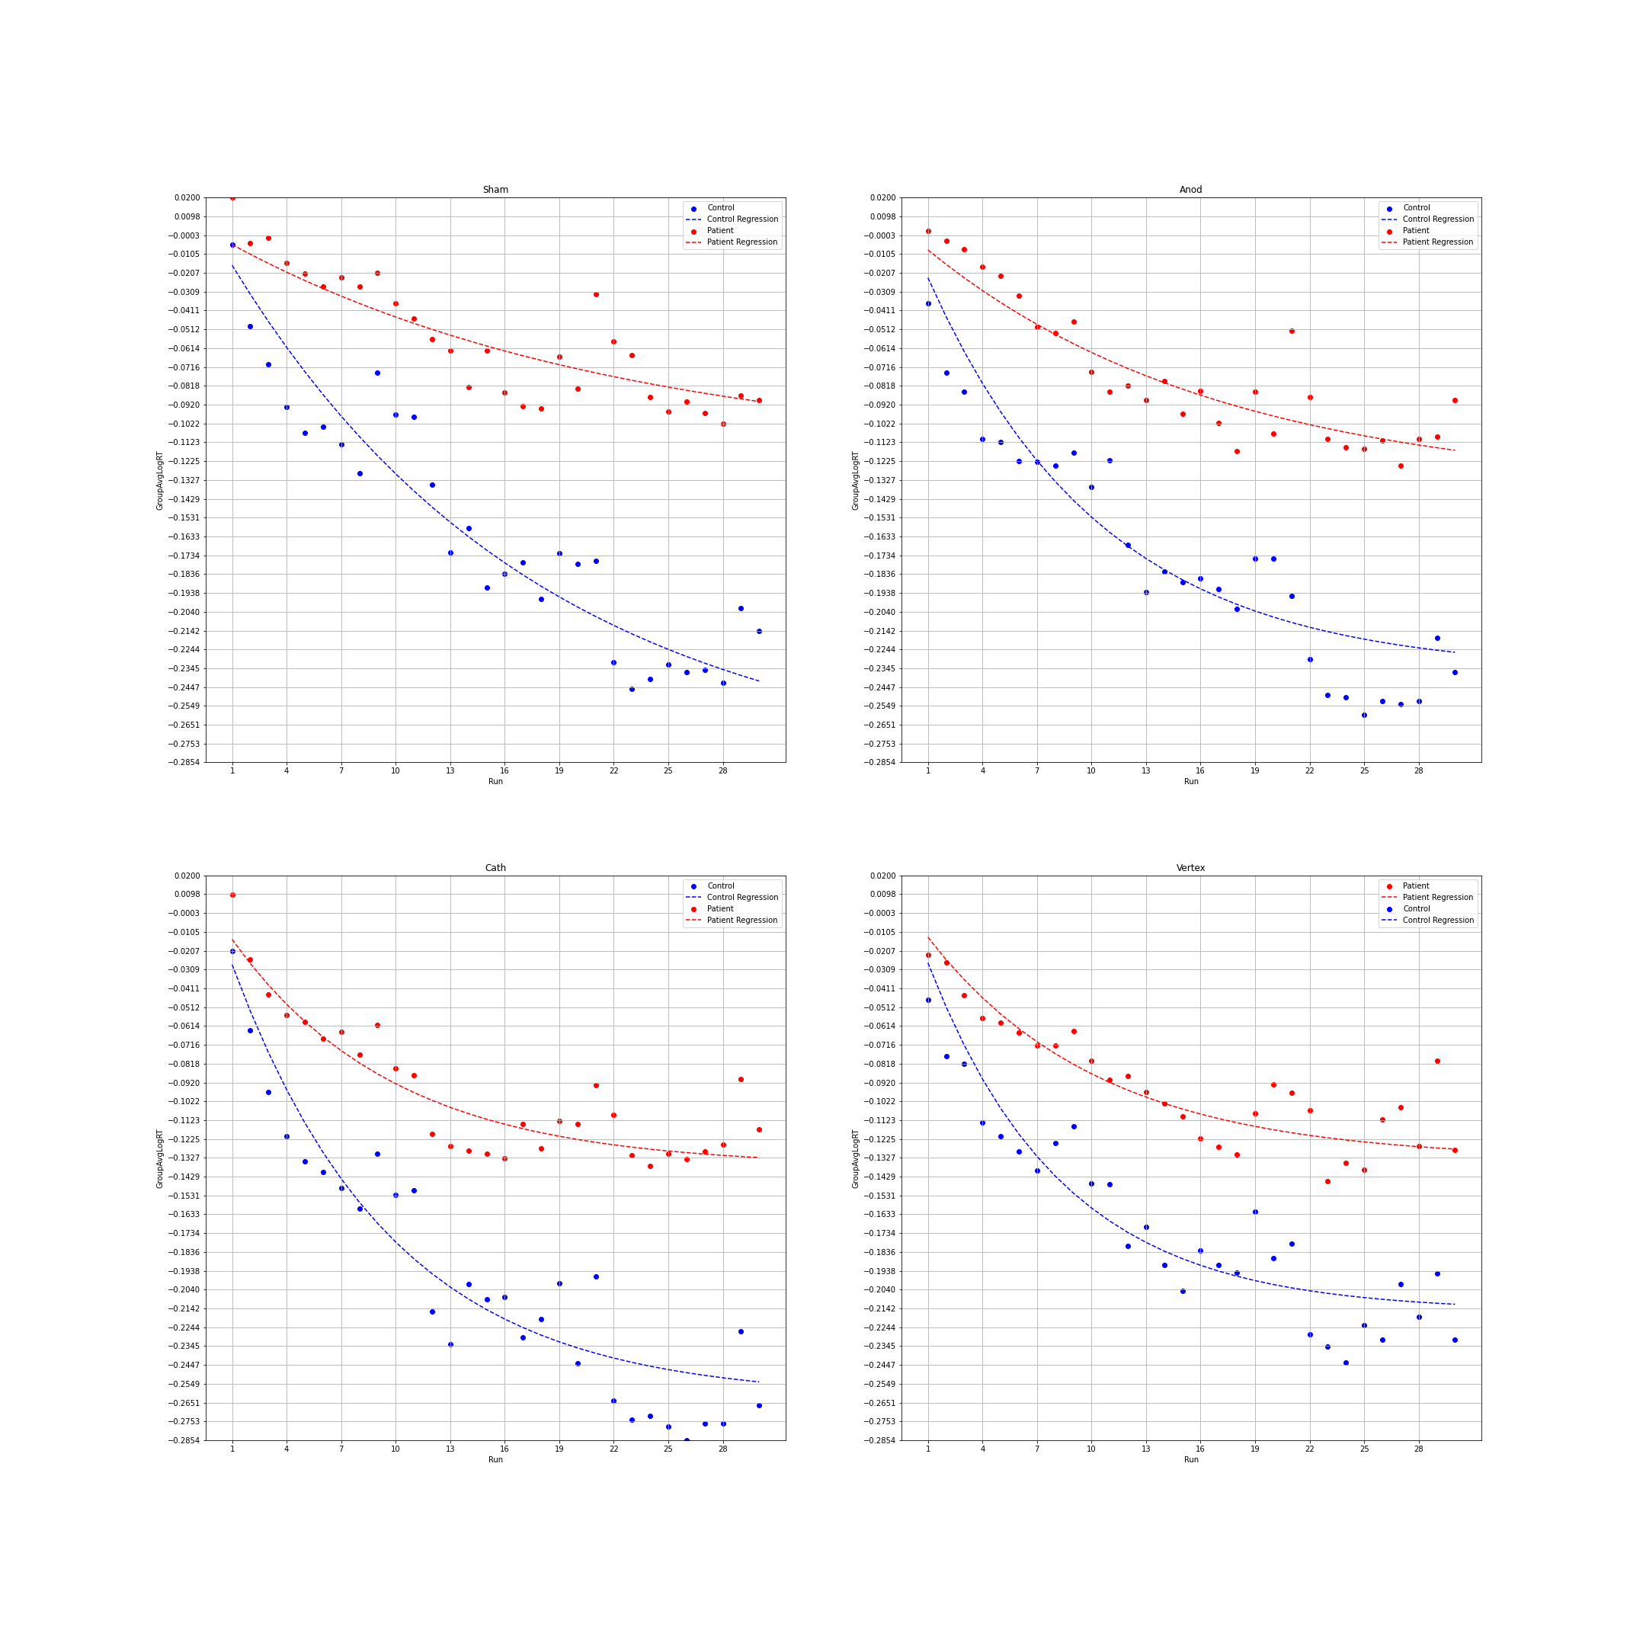
Sham
Cathodal Motor
Cathodal Visual
Anodal Motor
Bar graphs from mixed model
Just runs 0-23 (omit orig 10, 13, 22)
%RT values in same format

Slide 2
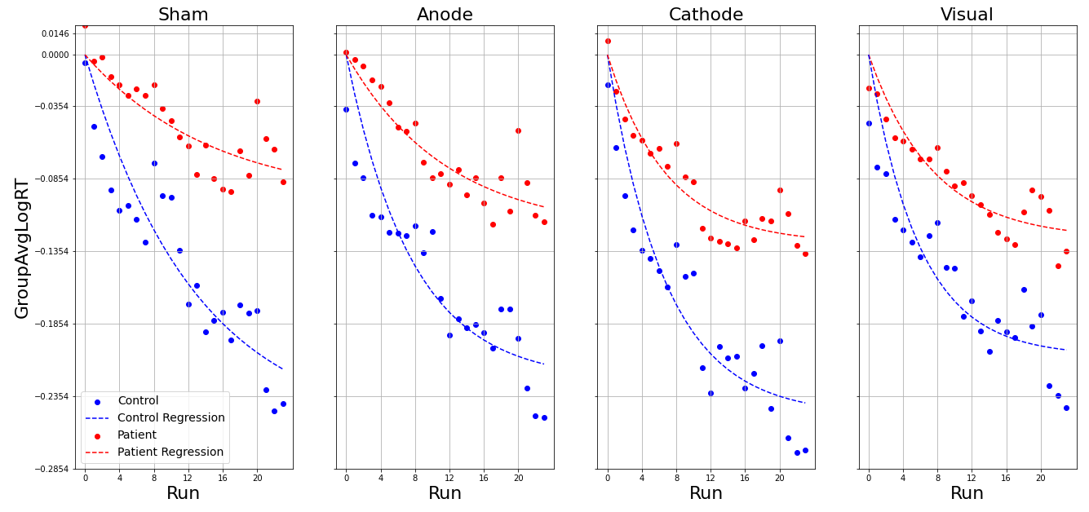
New Log RT Plots Updated (Oct 20th)

Slide 3
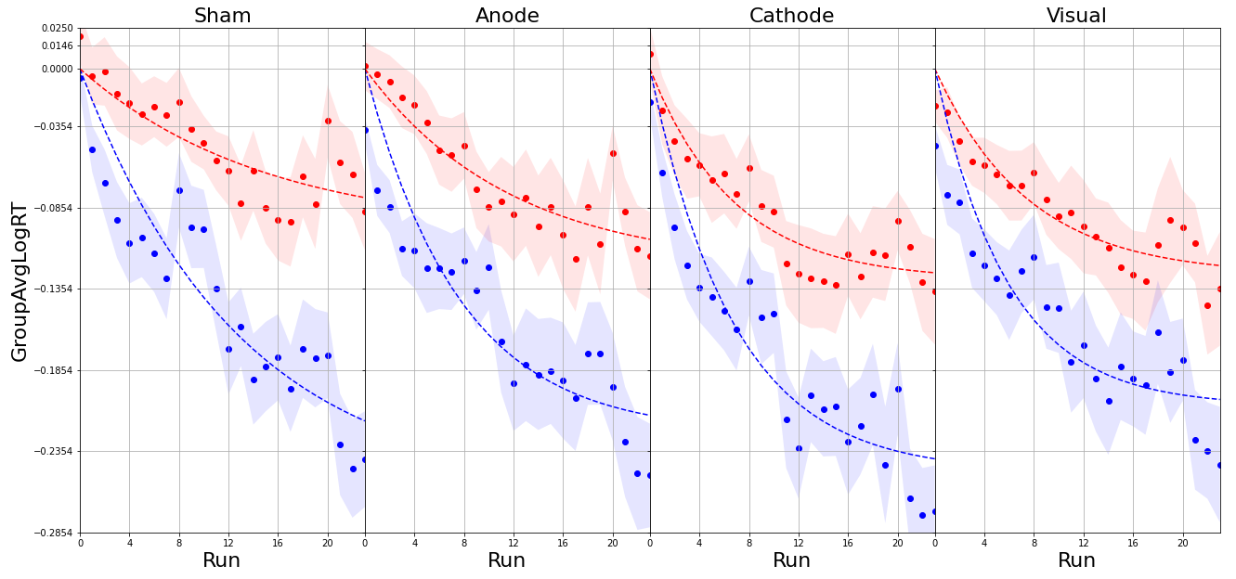
New Log RT Plots Updated (Oct 24th)

Slide 4
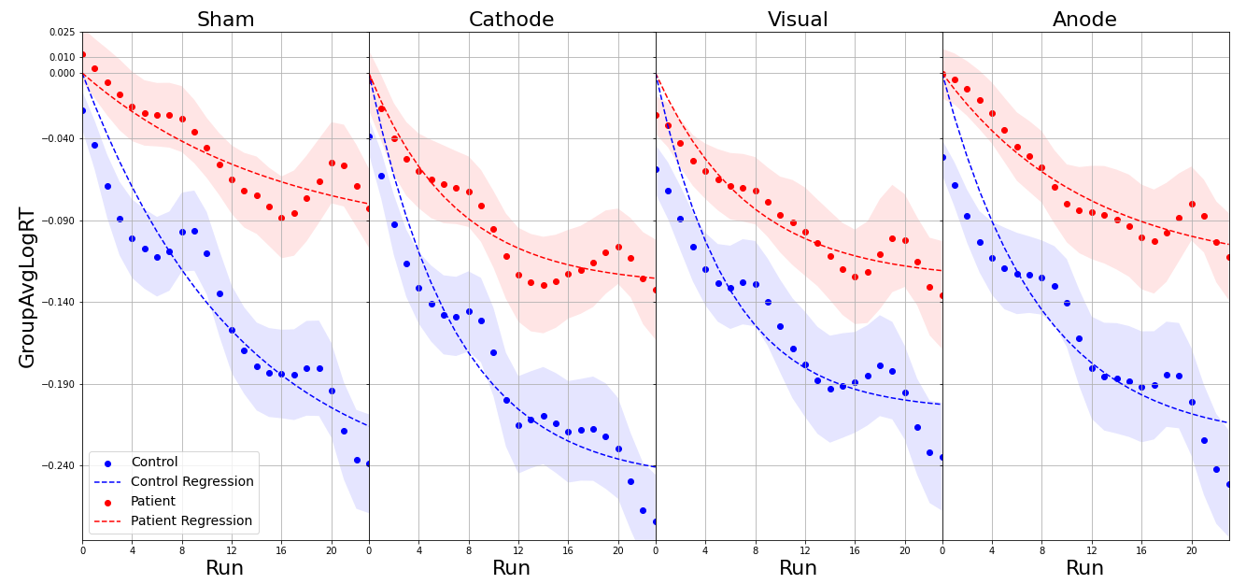
New Log RT Plots Updated (Oct 26th)
I have run a 1D gaussian filter with sigma value of 1 for both the datapoints and the associated SEMs. I have included the Legend to avoid confusion for now but will remove it.

Slide 5
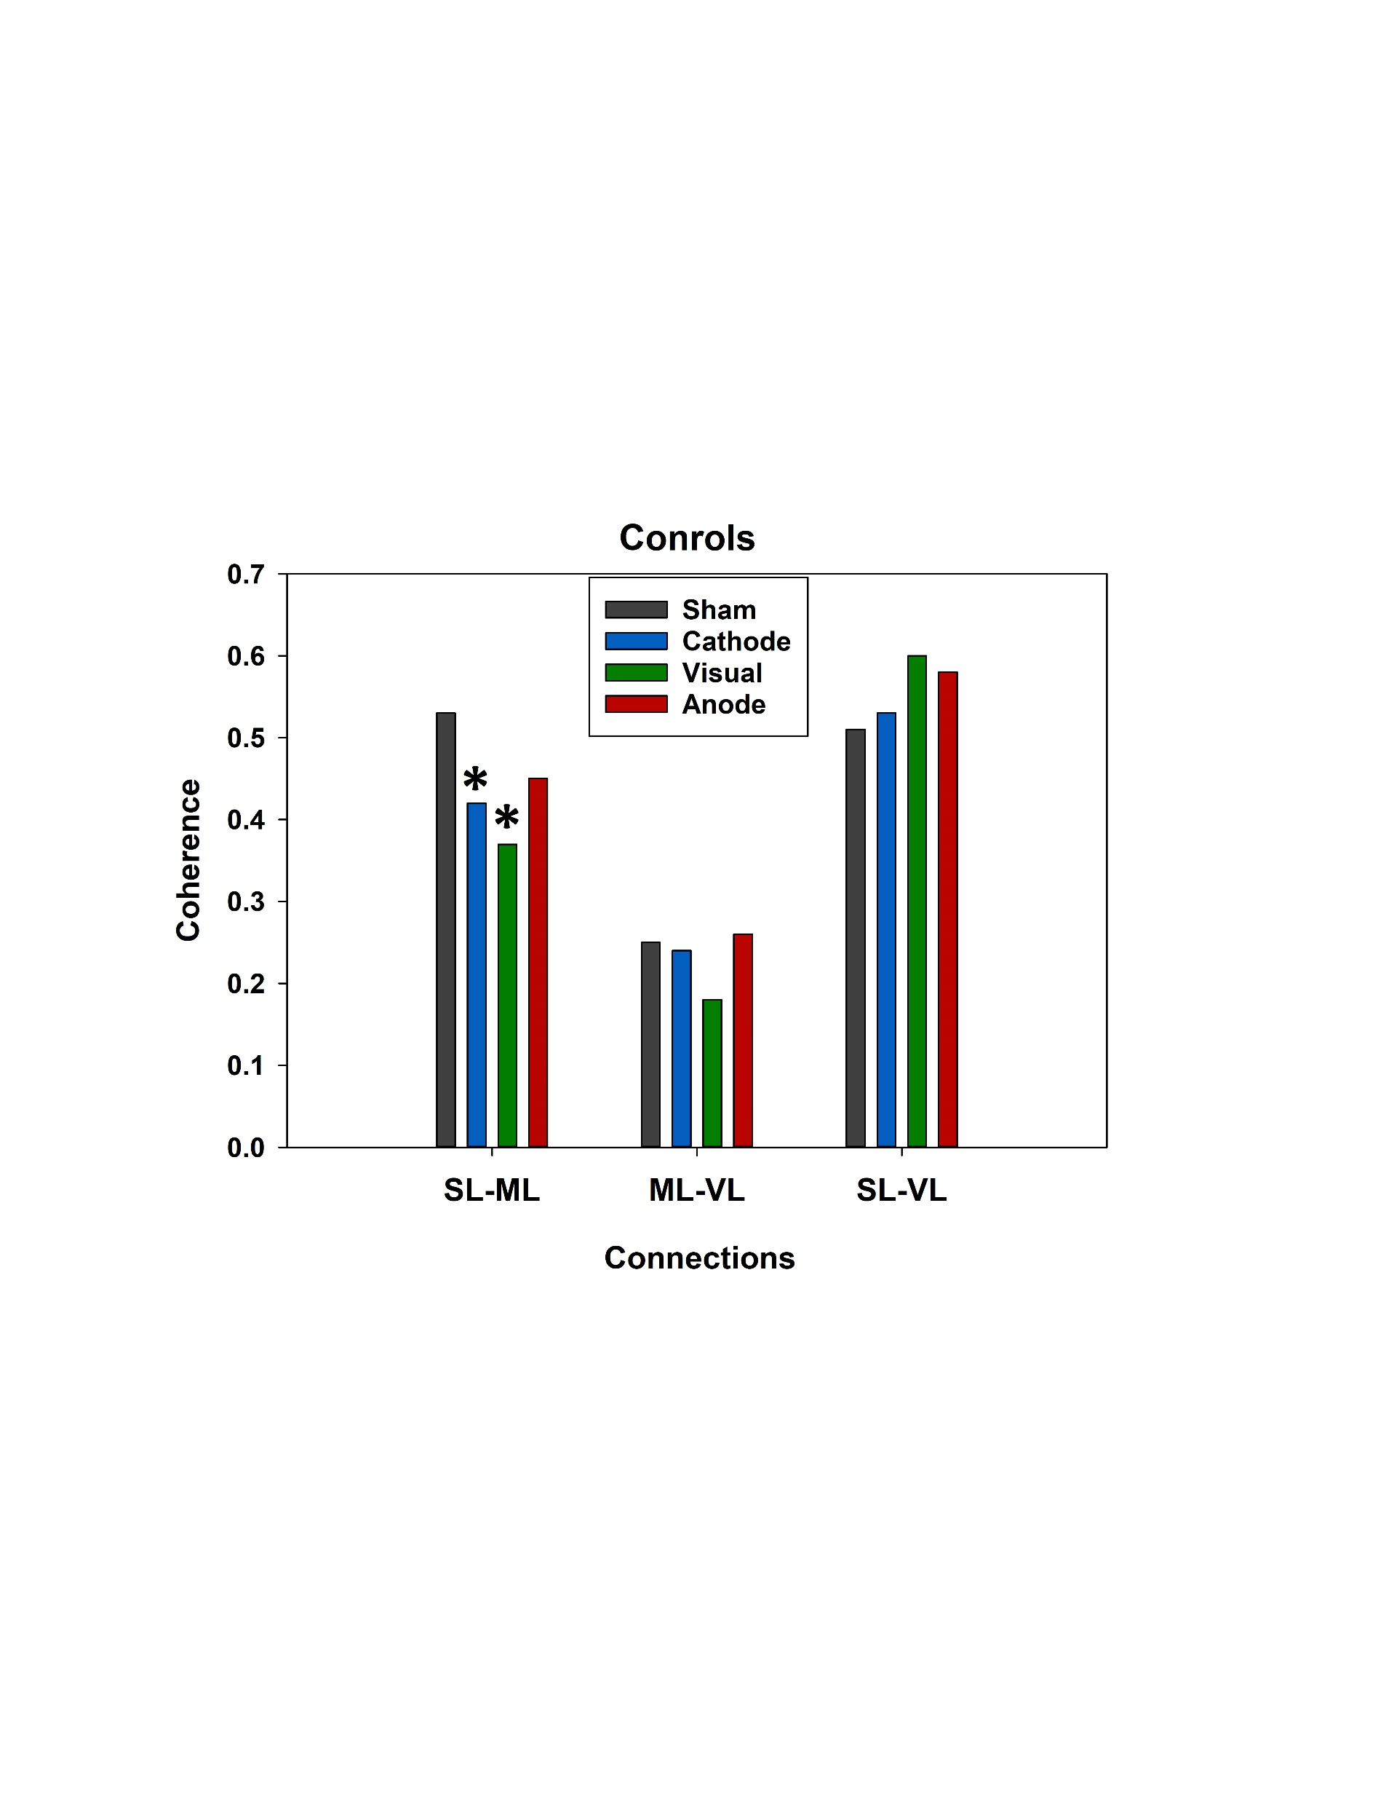

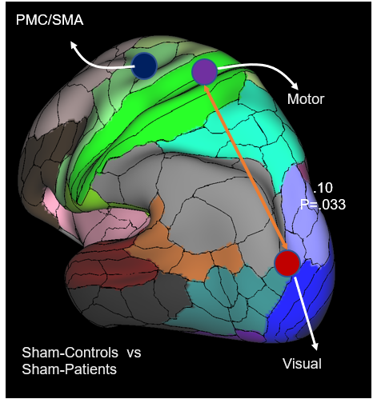
Controls
Coherence measures for Controls and Patients under each stimulation conditions
PMC/SMA
PMC/SMA
.SL-ML
.53
Motor
Motor
.SL-VL
.51
.ML-VL
.25
Sham
Sham
Visual
Visual
Patients
PMC/SMA
PMC/SMA
.10
P=.008
Motor
Motor
.07
P=.045
-.08
P=.046
Sham vs Motor-Cathodal
Visual
Sham vs Visual-Cathodal
Visual

Slide 6
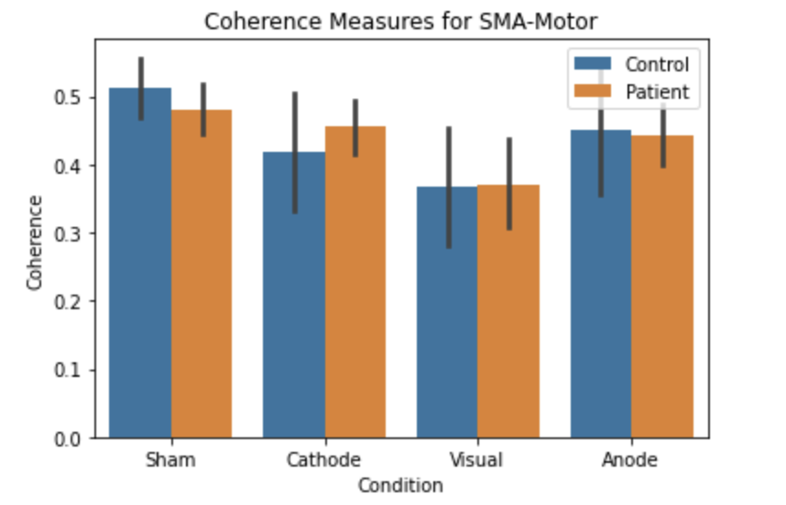

Slide 7
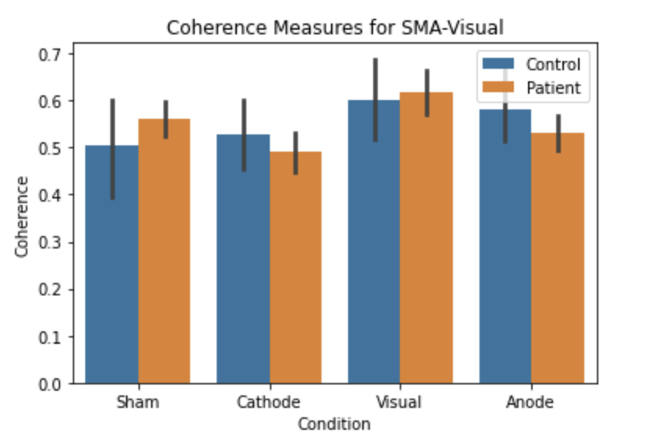

Slide 8
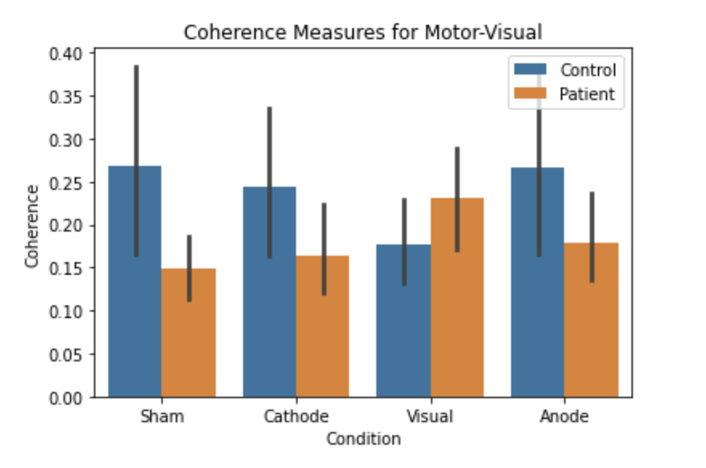

Slide 9
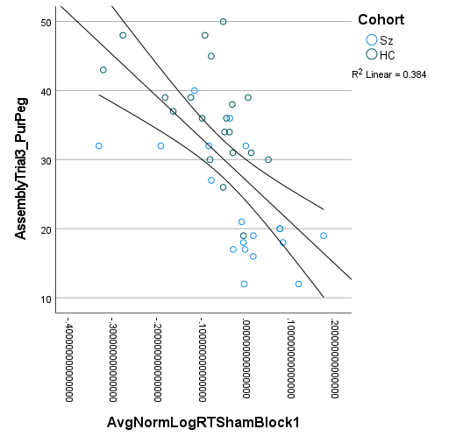
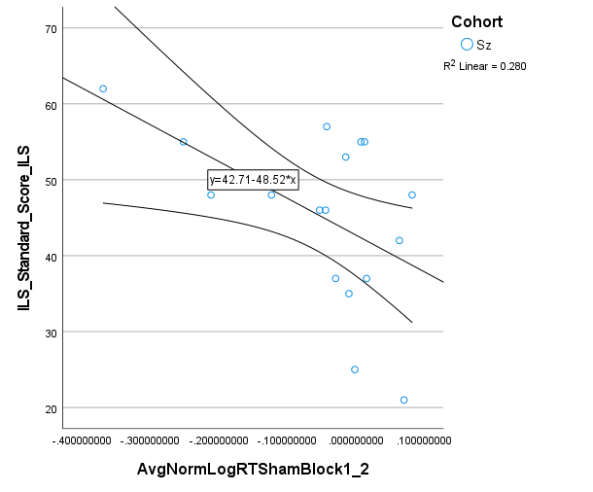

Slide 10
Sham
Cathodal Motor
Cathodal Visual
Anodal Motor

